Slide 1
Image Formation

Slide 2
Objectives
Fundamental imaging notions
Physical basis for image formation
Light
Color
Perception
Synthetic camera model
Other models

Slide 3
Image Formation
In computer graphics, we form images which are generally two dimensional using a process analogous to how images are formed by physical imaging systems
Cameras
Microscopes
Telescopes
Human visual system

Slide 4
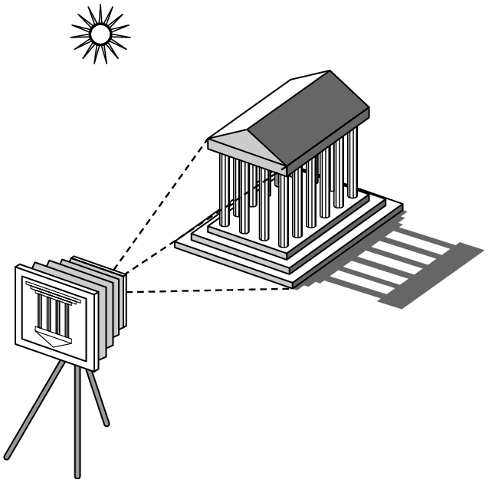
Elements of Image Formation
Objects
Viewer
Light source(s)
Attributes that govern how light interacts with the materials in the scene
Note the independence of the objects, the viewer, and the light source(s)

Slide 5
Light
Light is the part of the electromagnetic spectrum that causes a reaction in our visual systems
Generally, these are wavelengths in the range of about 350-750 nm (nanometers)
Long wavelengths appear as reds and short wavelengths as blues

Slide 6
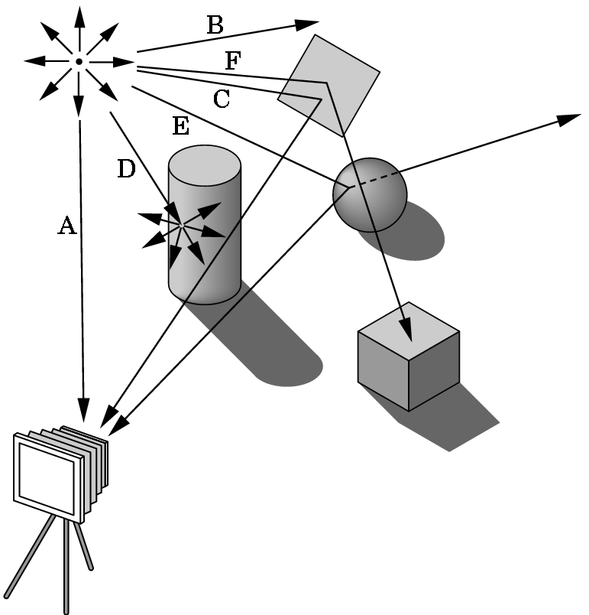
Ray Tracing and Geometric Optics
One way to form an image is to follow rays of light from a point source finding which rays enter the lens of the camera.
However, each ray of light may have multiple interactions with objects before being absorbed or going to infinity.

Slide 7
Luminance and Color Images
Luminance Image
Monochromatic
Values are gray levels
Analogous to working with black and white film or television
Color Image
Has perceptional attributes of hue, saturation, and lightness

Slide 8
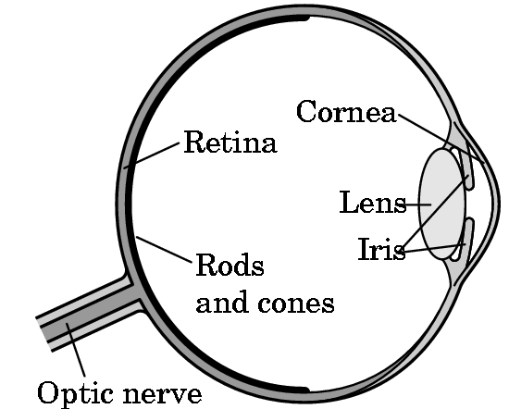
Three-Color Theory
Human visual system has two types of sensors
Rods: monochromatic, night vision
Cones
Color sensitive
The three types of cones in the human eye are:
Red or long wavelength sensitive cones: Also known as L-cones
Green or medium wavelength cones: Also known as M-cones
Blue or short wavelength cones: Also known as S-cones
These cones are responsible for color vision in humans.
The brain combines signals from these cones to distinguish thousands of colors
Only three values (the tristimulus values) are sent to the brain
Need only match these three values
Need only three primary colors

Slide 9
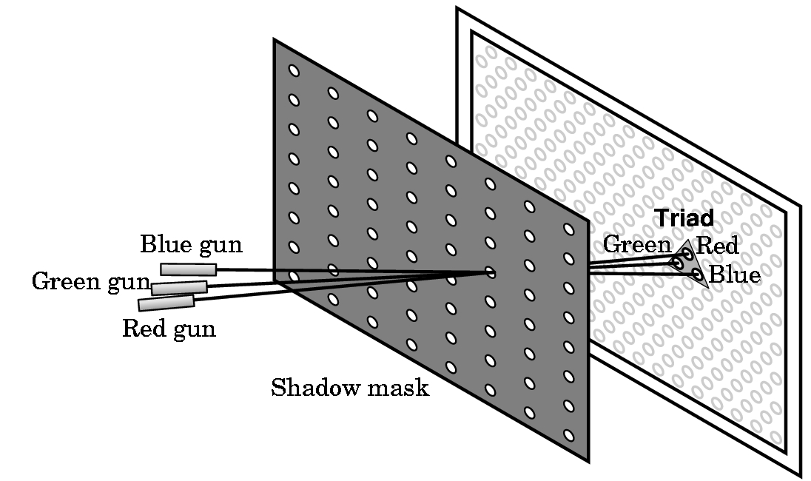
Shadow Mask CRT

Slide 10
Additive and Subtractive Color
Additive color
Form a color by adding amounts of three primaries
CRTs, projection systems, positive film
Primaries are Red (R), Green (G), Blue (B)
Subtractive color
Form a color by filtering white light with cyan (C), Magenta (M), and Yellow (Y) filters
Light-material interactions
Printing
Negative film

Slide 11
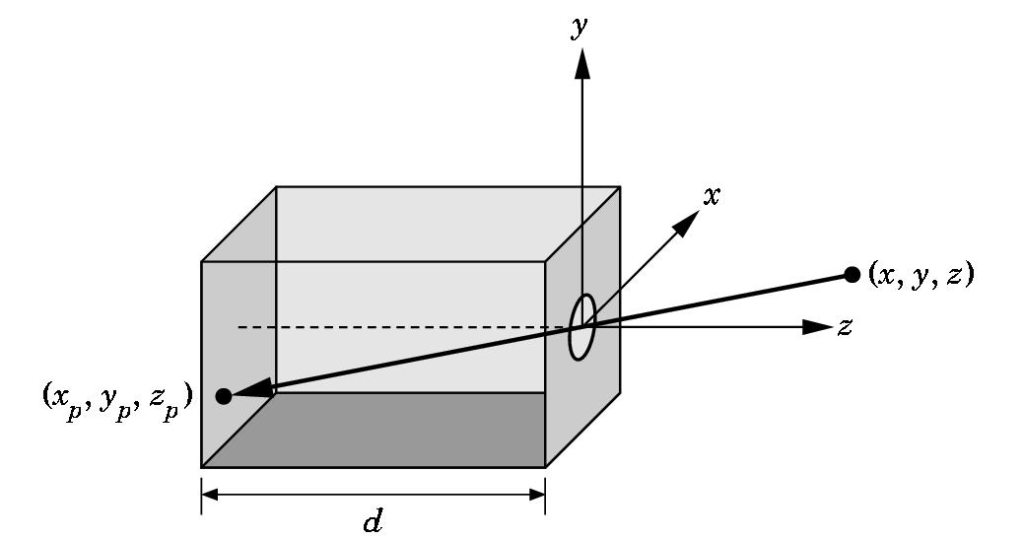
Pinhole Camera
Use trigonometry to find projection of point at (x,y,z)
x_{p}= -x/z/d
y_{p}= -y/z/d
z_{p}= d
These are equations of simple perspective

Slide 12
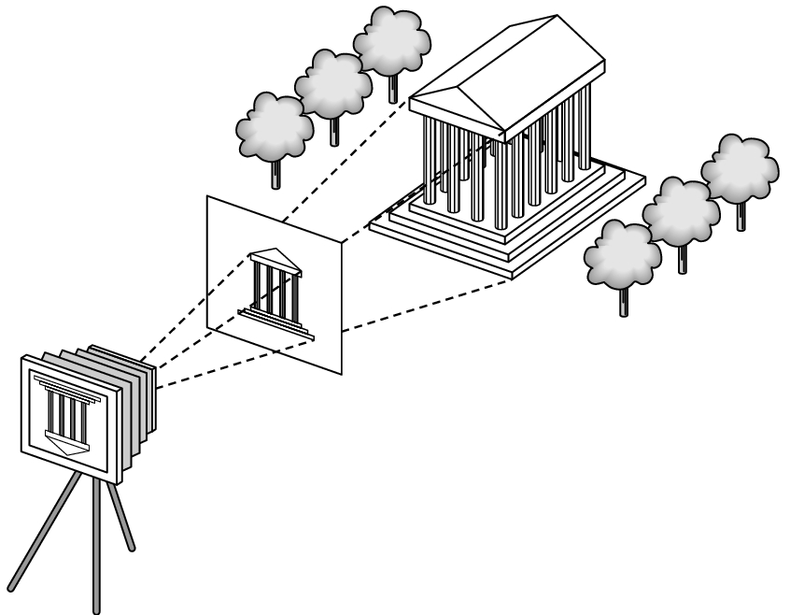
Synthetic Camera Model
projector
p
image plane
projection of p
center of projection

Slide 13
Advantages
Separation of objects, viewer, light sources
Two-dimensional graphics is a special case of three-dimensional graphics
Leads to simple software API
Specify objects, lights, camera, attributes
Let implementation determine image
Leads to fast hardware implementation

Slide 14
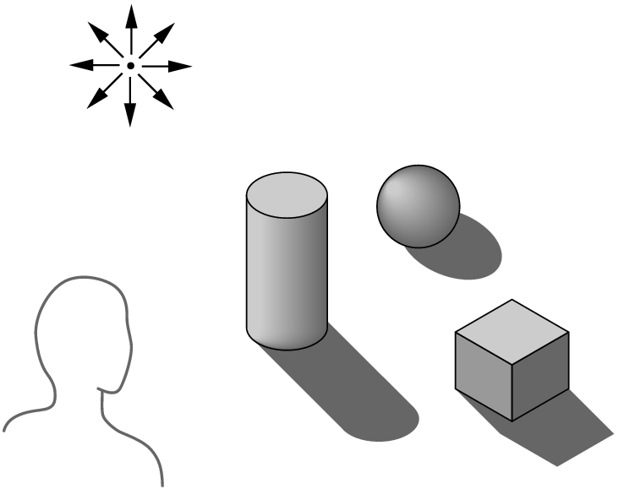
Global vs Local Lighting
Cannot compute color or shade of each object independently
Some objects are blocked from light
Light can reflect from object to object
Some objects might be translucent

